Slide 1

Case Study
Cyclistic bike-share analysis

Slide 2






Content
1.
Business Model
2.
Business Task
3.
Data Model
4.
Measurement
5.
Visualization
6.
ADVISE

Slide 3
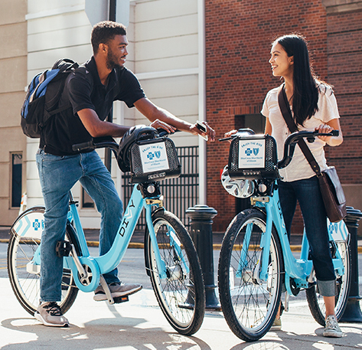
Cyclistic
Location: Chicago
Assets: 5,824 bicycles
Stations: 692
Customer group:
casual
Annual

Slide 4



Business Task
1. Characteristics on annual & casual rider
2. Why casual would buy annual membership
3. How digital media can affect decision making in task 2.

Slide 5
DATA MODEL

